Slide 1
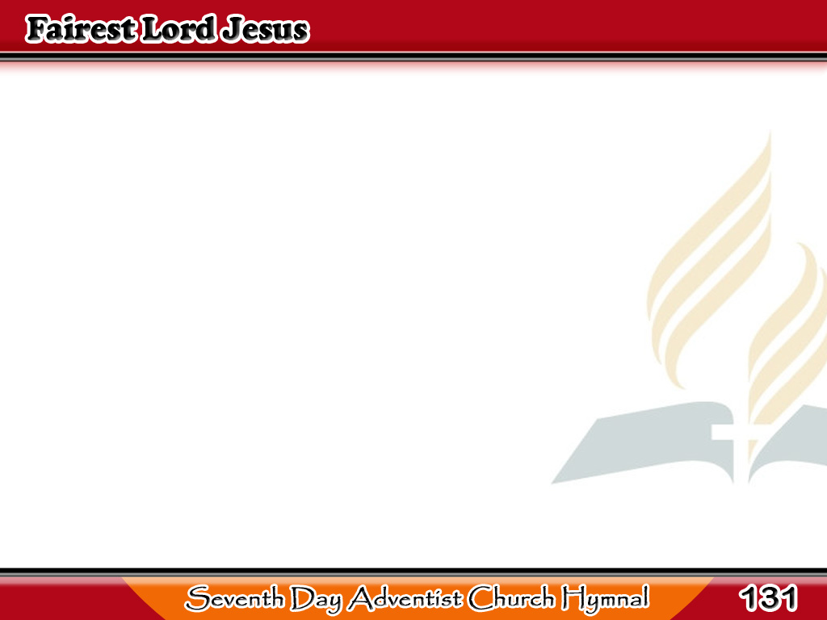
Magandang Jesus
Fairest Lord Jesus,
Ruler of all nature,
O thou of God
and man the Son!
1/4

Slide 2
Magandang Jesus
Thee will I cherish,
Thee will I honor,
Thou art my glory,
joy, and crown.
1/4

Slide 3
Magandang Jesus
Fair are the meadows,
Fairer still the woodlands,
Robed in the blooming
garb of spring;
2/4

Slide 4
Magandang Jesus
Jesus is fairer,
Jesus is purer,
Who makes the woeful
heart to sing.
2/4

Slide 5
Magandang Jesus
Fairer the sunshine,
Fairer still the moonlight,
And all the twinkling,
starry host;
3/4

Slide 6
Magandang Jesus
Jesus shines brighter,
Jesus shines purer
Than all the angels
heaven can boast.
3/4

Slide 7
Magandang Jesus
Beautiful Savior,
Lord of the nations,
Son of God and Son of Man!
4/4

Slide 8
Magandang Jesus
Glory and honor,
Praise, adoration,
Now and forevermore
be Thine!
4/4

